Slide 1
amble
Assignment 6
Frieda R., Kelsey Z, Rickenson R., Thomas E.

Slide 2
Overview
VALUE PROPOSITION
PROBLEM & SOLUTION
VALUES ENCODED
TASKS
USABILITY GOALS & MEASUREMENTS
INTERFACE DESIGN
PROTOTYPE OVERVIEW

Slide 3
GIVE YOUR CREATIVE CURIOSITIES SOME DIRECTION!
Many people struggle with choice paralysis when it comes to starting and finishing creative tasks. Amble provides direction by giving users a customized roadmap to achieve their artistic goals and explore curiosities without the pressure of expectations.

Slide 4
Values
Within our platform, we aim to encode the values of efficiency, learnability, and inclusivity for users. As we build amble, our goal is to embed these values through a deep understanding of our users and the context in which amble will be used.
Efficient design for users to easily and logically navigate
Learnable elements and content
Inclusive platform that caters to a diverse audience

Slide 5
Task 1 - Simple
“Input and save ideas into one platform”
You’ve been feeling inspired to learn to draw at some point. Navigate the app to make a quick note of your idea!

Slide 6
Task 2 - Medium
“Explore interests in a friendly, easy to use manner”
You just jotted down an idea and there’s a new notification to start learning! Use the app to begin your exploration.

Slide 7
Task 3 - Complex
“Build on previous hobbies by receiving suggestions on what to explore next”
You’ve had a great time learning skills you’ve sought out. Looks like the app has some recommendations for what’s next! Navigate the app to discover suggestions.

Slide 8
Usability Goals & Key Measurements
We focus on discovering how efficient, learnable, and inclusive our platform is for users.
Learnability: judged the speed and amount that users improved their navigation of the platform when asked to do perform each task
Efficiency: judged as how easily users were able to complete a task without confusion or questions
Inclusivity: measured how naturally users felt they were able to do a task regardless of their skill level with using technology and ability to learn

Slide 9
Revised Interface Design
Potential Improvements:
Clarifying the navigation using the menu bar
Showing that there is a specific area for note-taking and gathering inspiration
Minimize unnecessary steps to get to a specified screen

Slide 10
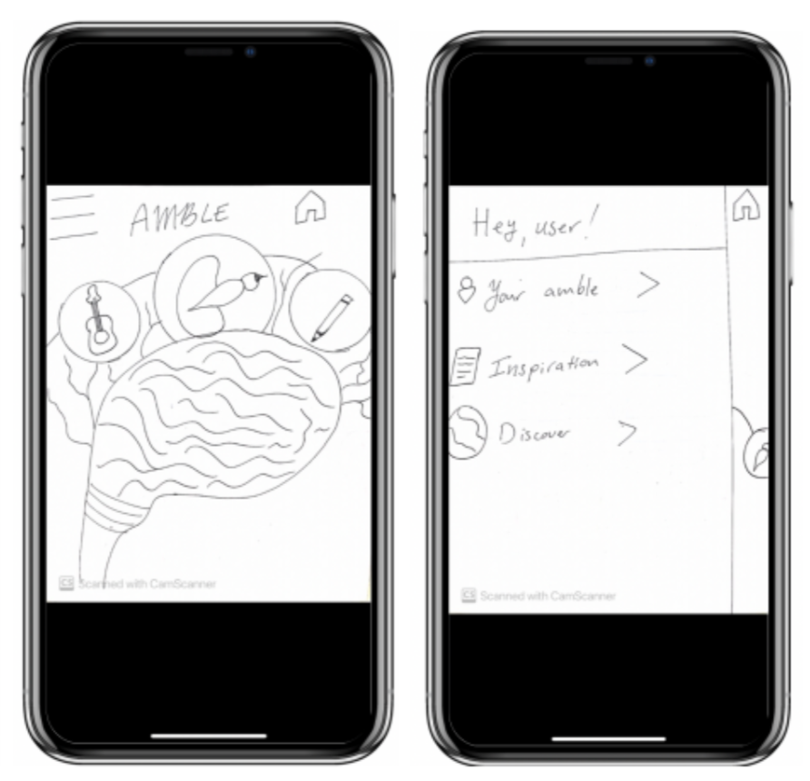
Revised Interface Design 1
Before: Confusion as to what the home screen icons are representing

Slide 11
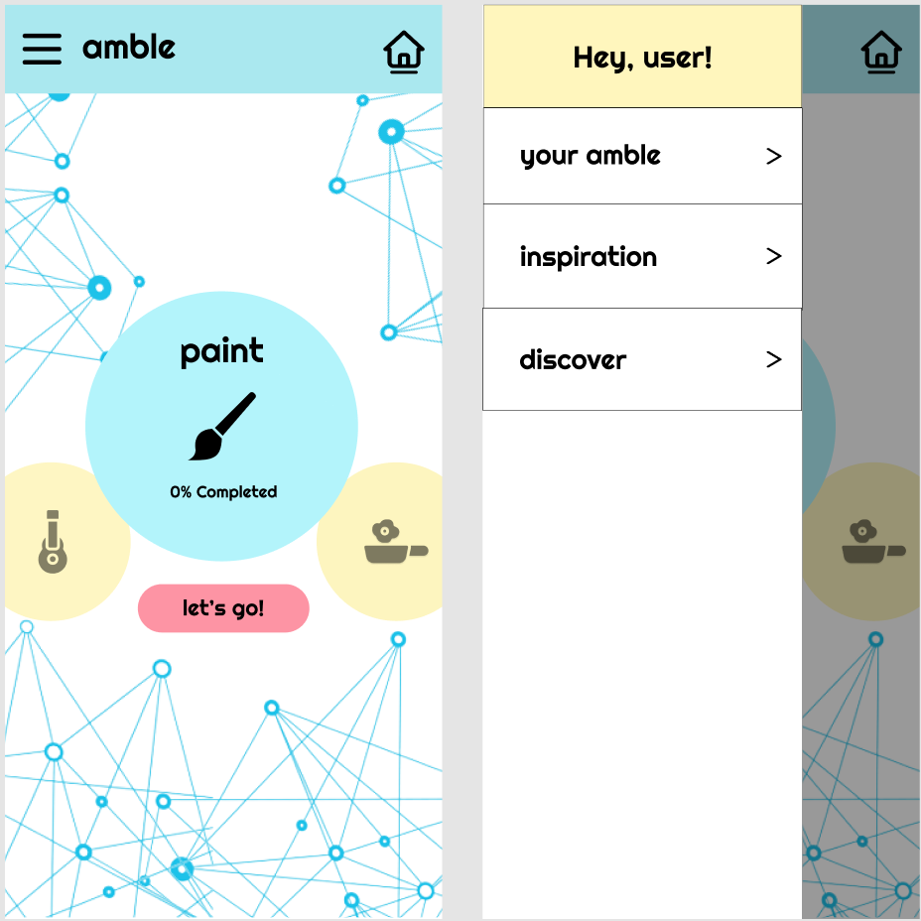
Revised Interface Design 1
After: Clarified home screen sections

Slide 12
Rationale
Changes:
Added text to clarify what the buttons on the home screen represent
Made the menu navigation clearer and easier to see
These changes help the user navigate faster and with less steps to find the notes area

Slide 13
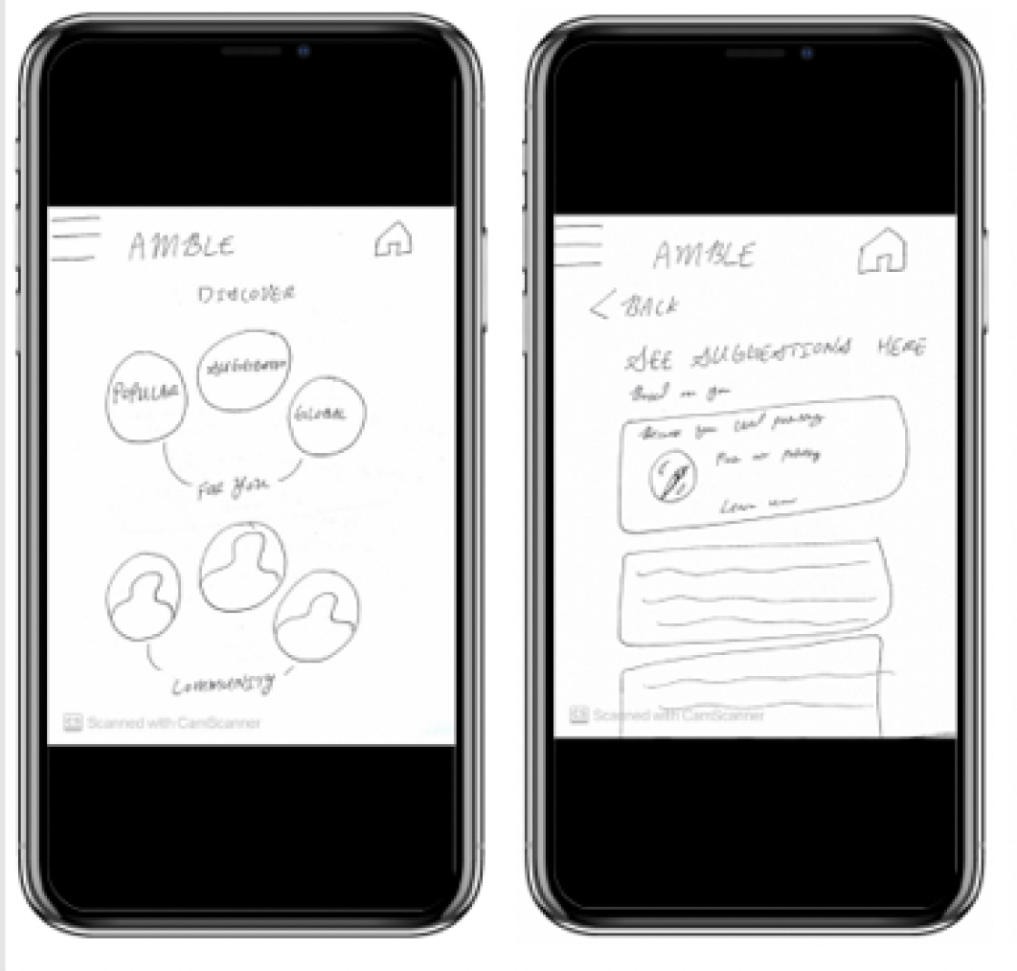
Revised Interface Design 2
Before: Notifications unclear and inconsistently placed

Slide 14
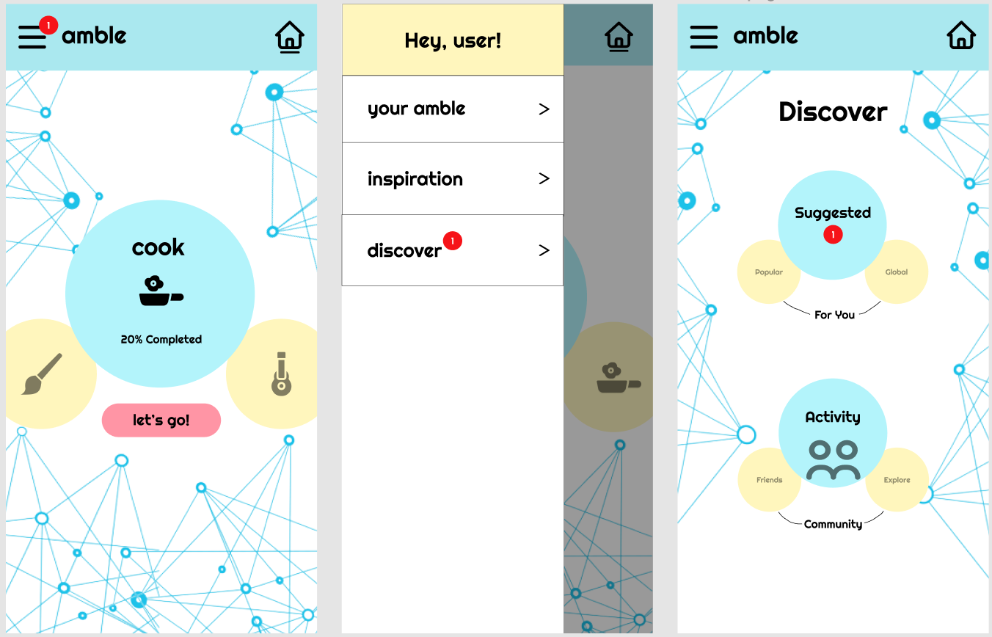
Revised Interface Design 2
After: Re-designed the notification elements for clarity

Slide 15
Rationale
Changes:
Redesigned the notification button from a text to a red icon on the menu bar
Kept the notification design consistent throughout the steps to reach discover destination
The redesign makes it clearer to the user on where to tap

Slide 16
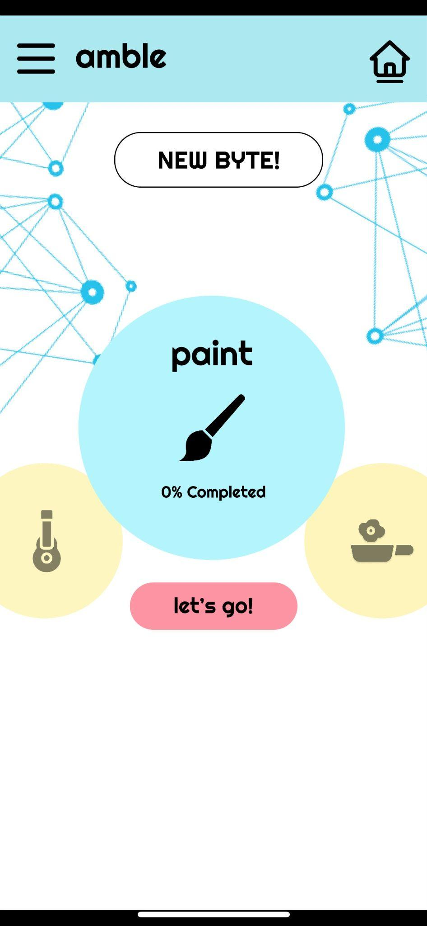
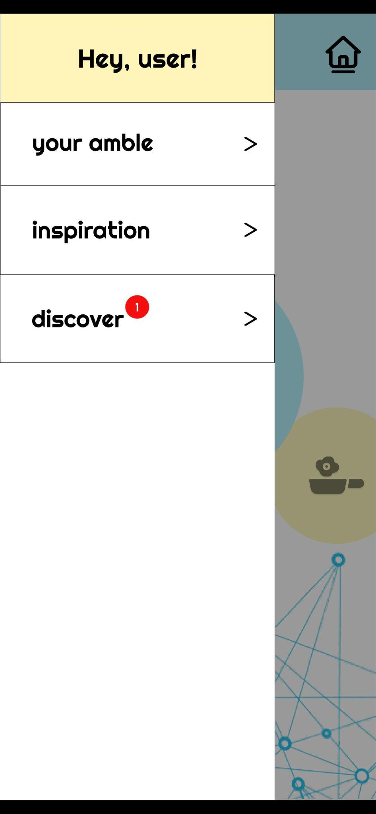
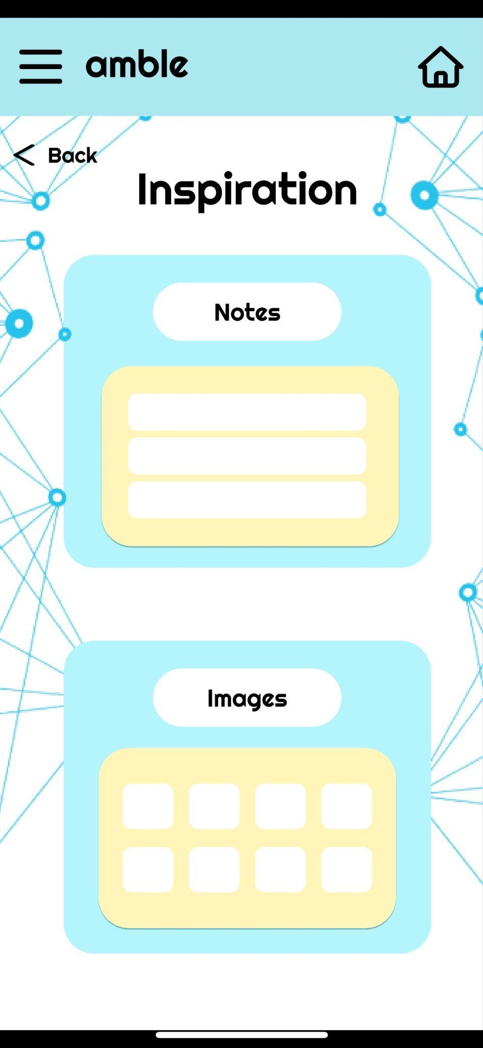
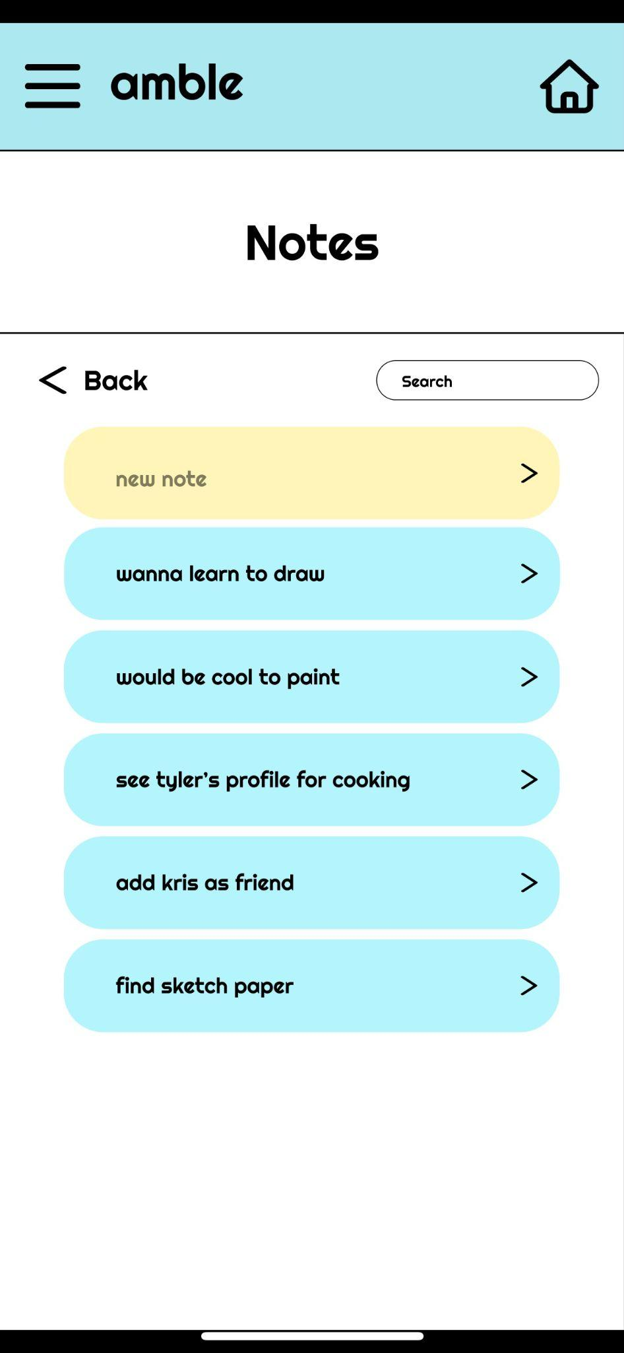
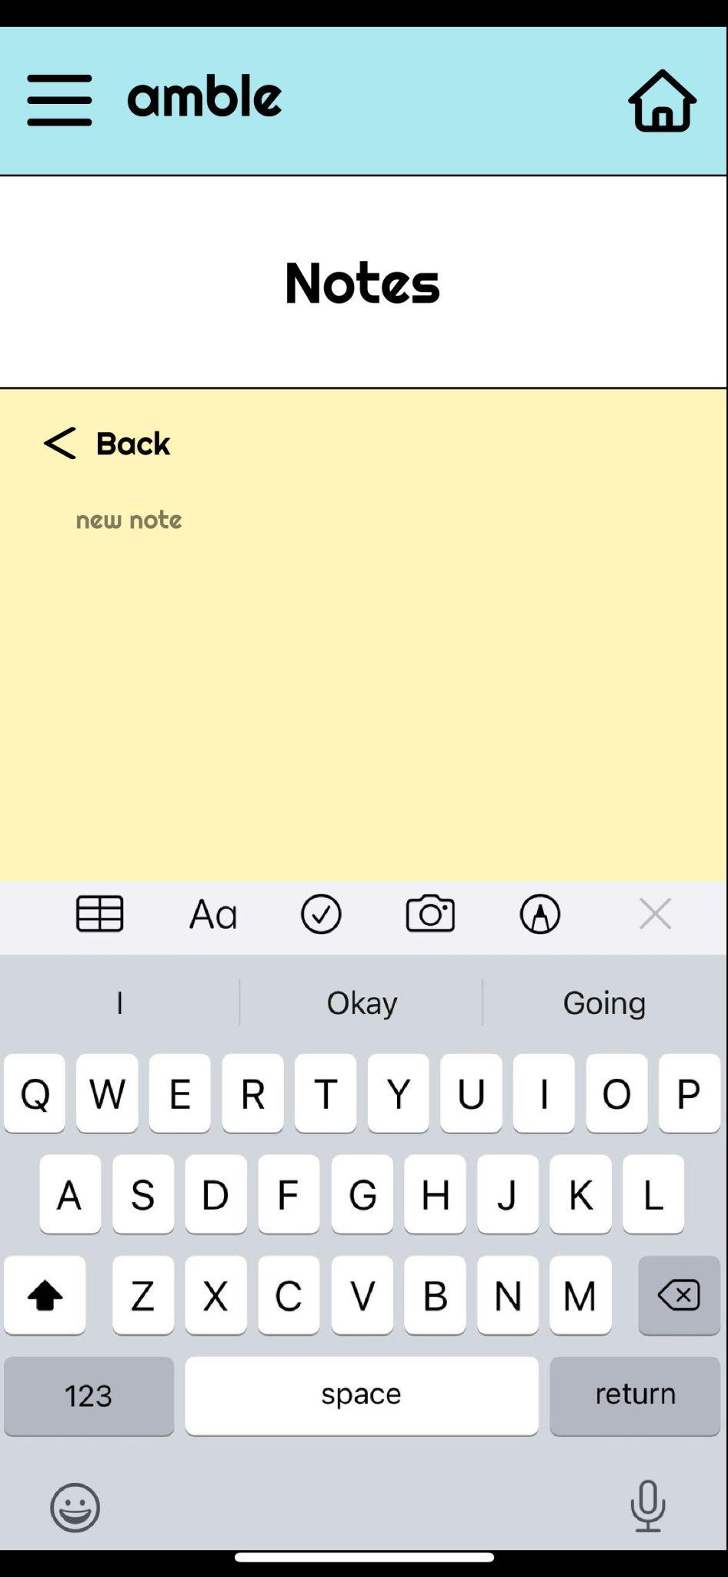
Prototype - Task 1 Flow
Loading screen
Home screen - find notes area
Menu bar
Inspiration screen
Notes page
Make a new note screen

Slide 17
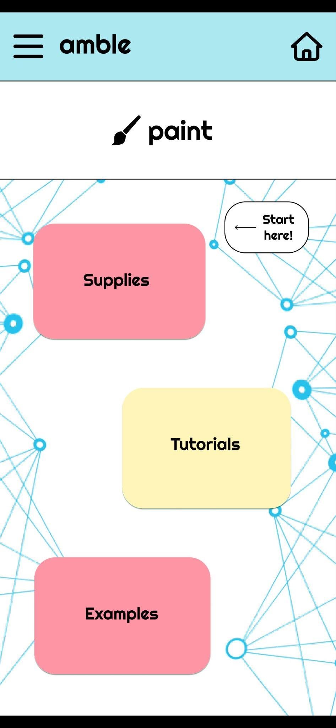
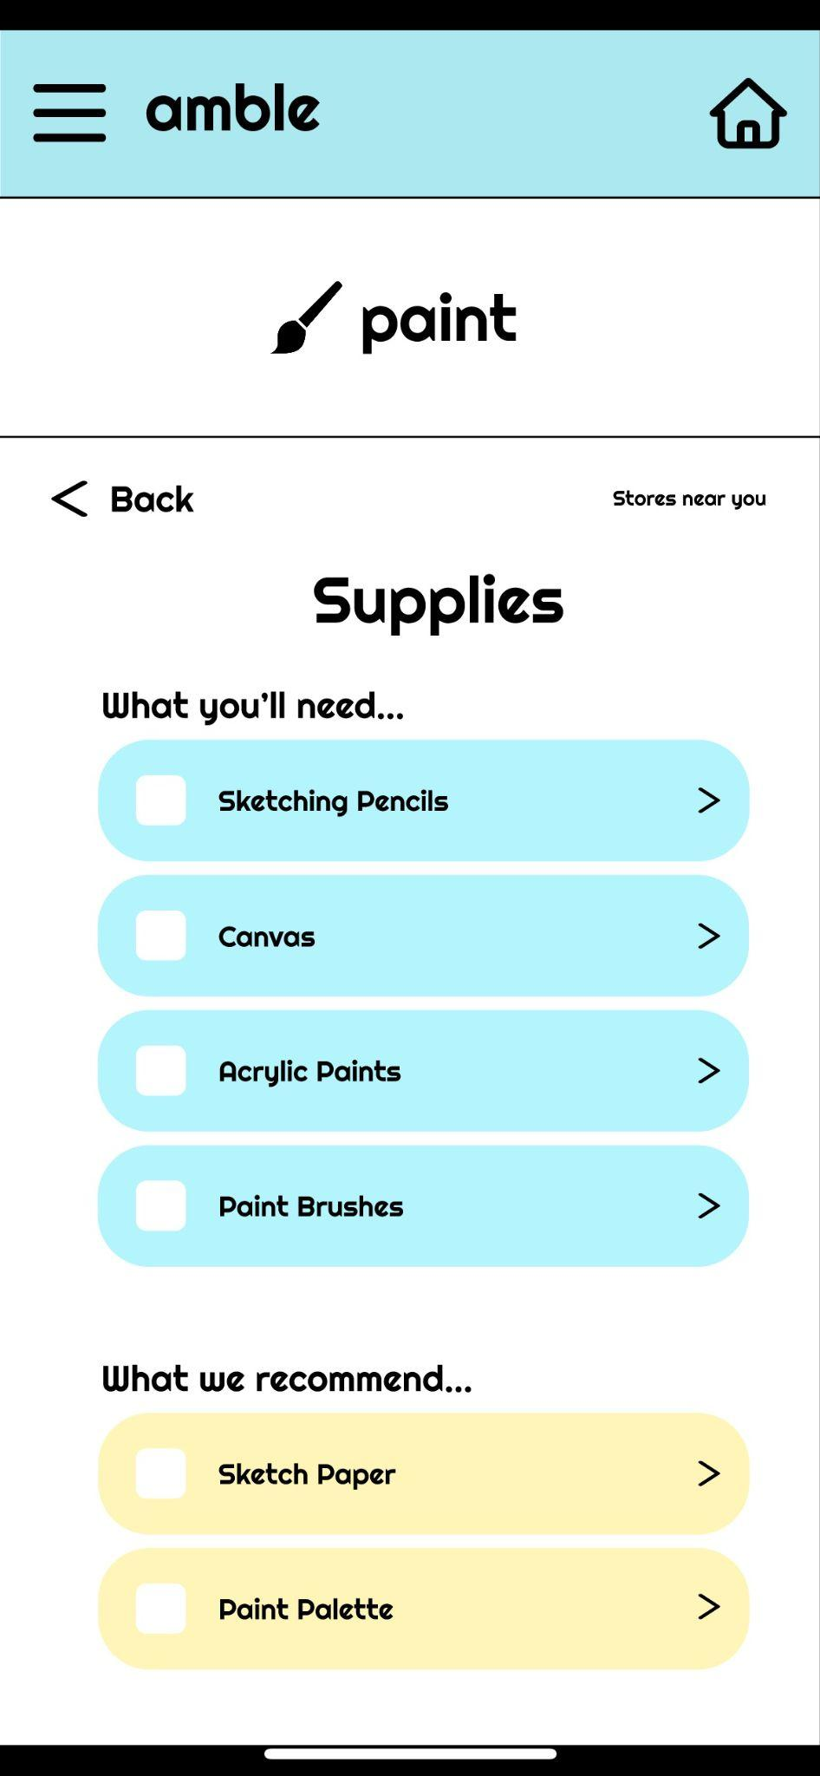
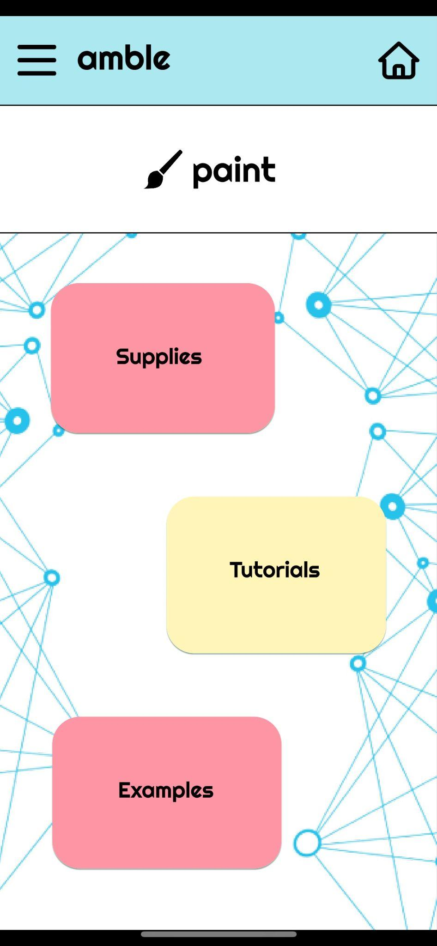
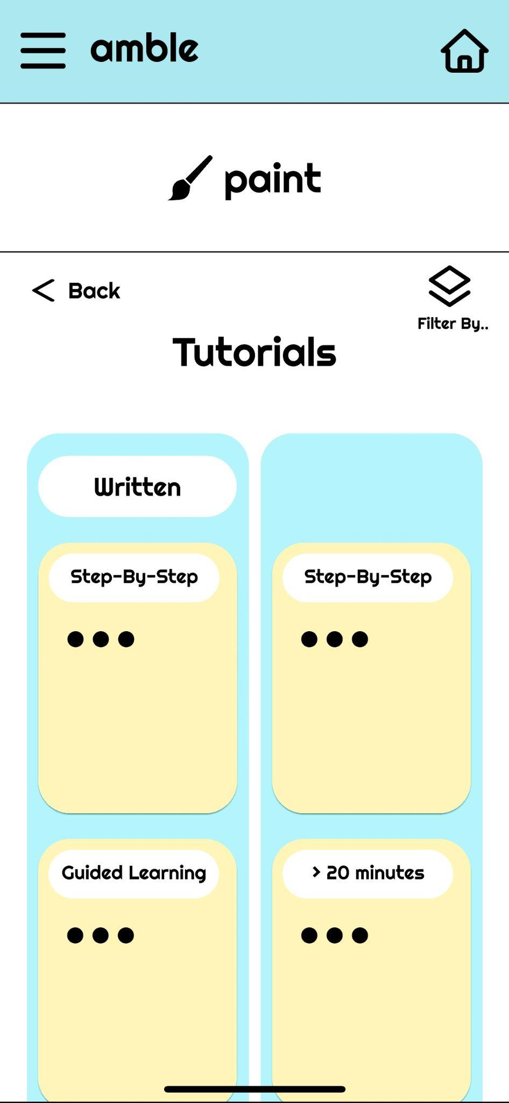
Prototype - Task 2 Flow
Home screen
Start learning new byte
Begin w supplies
Use tutorials
Tutorials screen

Slide 18
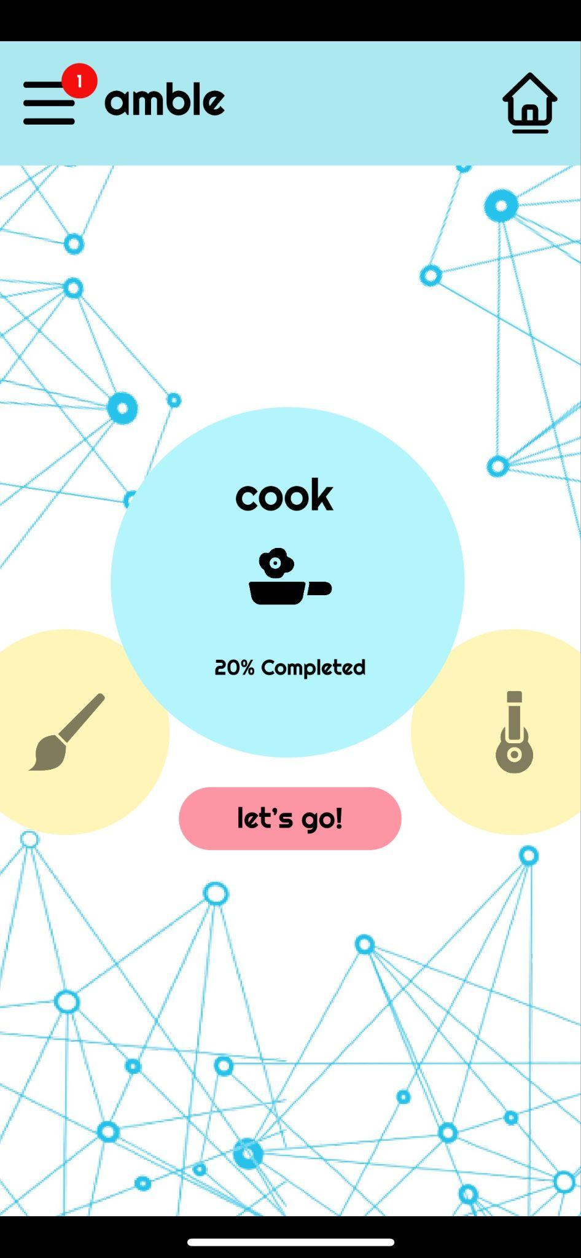
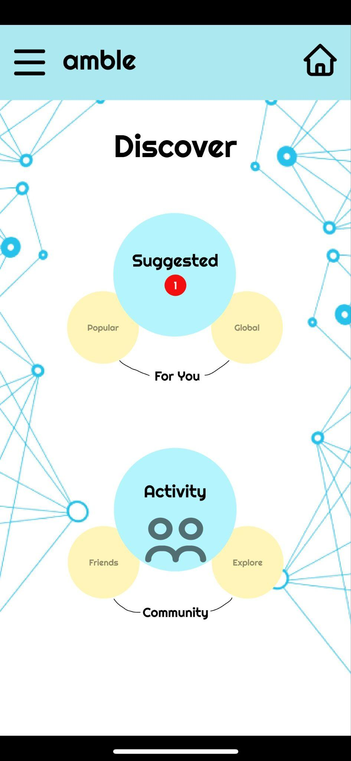
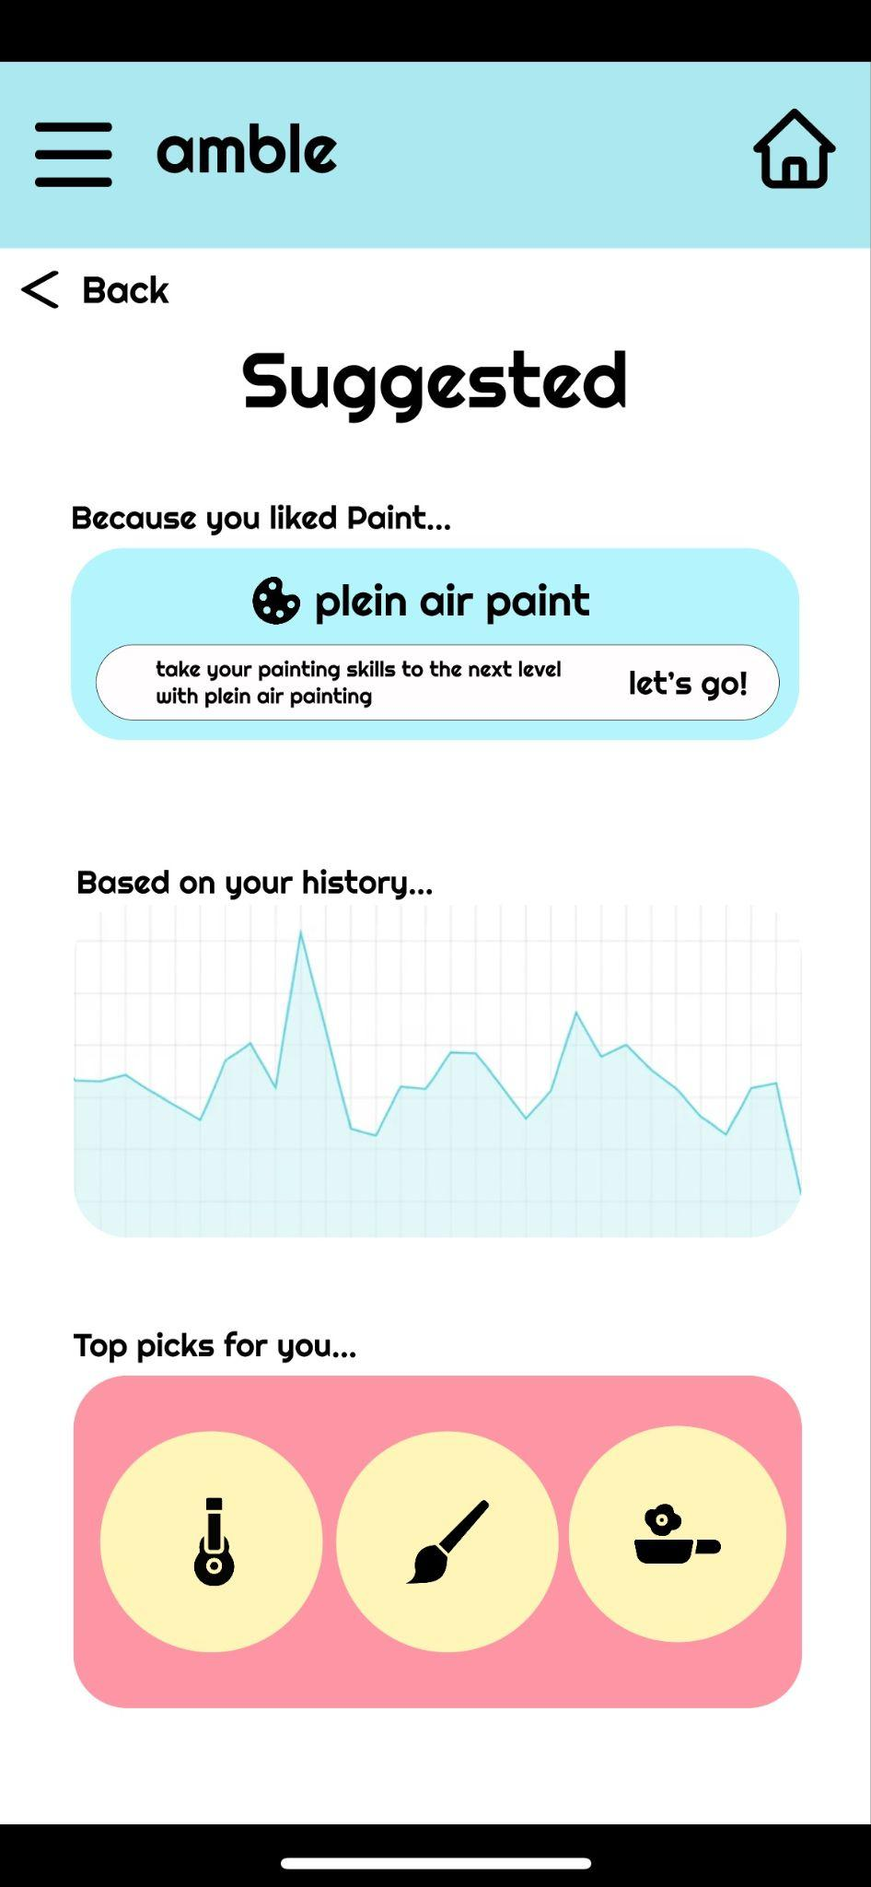
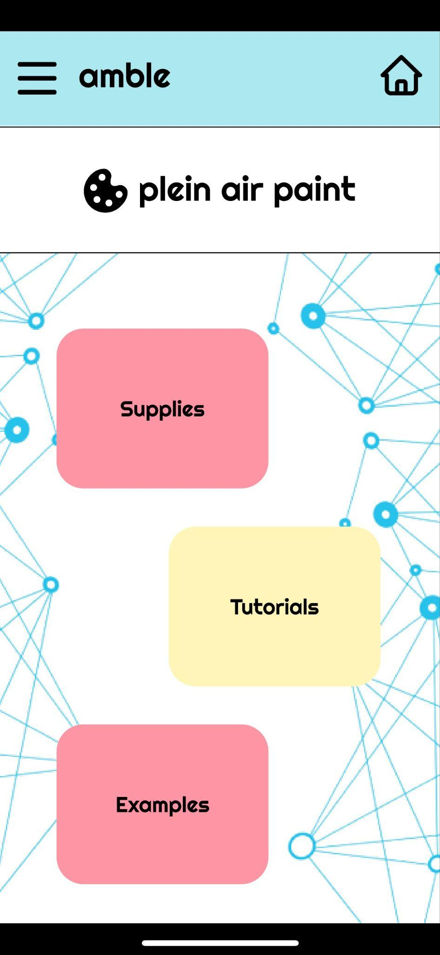
Prototype - Task 3 Flow
Home screen
Navigate to menu bar
Discover screen
See app suggestions
Suggested new byte

Slide 19
Prototype Overview: Tools & Hard-Coded Features
To build our prototype, we used figma to create the design flows. We used flaticons to find icon images, and we created the button graphics using figma’s design tools.
The pros of using figma are that the team was able to edit in real time, and there are many design options available. Cons are that we had to find icons not on the platform and had to keep track of organization.
We hardcoded the project bytes as pre-loaded options for users, as well as the profile analytics graphics and recommendations.

Slide 20
Prototype Overview: Limitations
Our prototype displayed a helpful flow of tasks and graphics, but certain limitations are with the information that will actually be available on the platform. We were limited by hard-coded elements which will not be the case in the real version, as well as limited interactions with the figma implementation.
This prototype shows us the potential for our features, which will utilize a more curated experience for the user rather than static content as shown in the med-fi prototype.

Slide 21
Prototype Overview: Wizard of Oz
Our app will incorporate an image-recognition feature that requires an AI trained algorithm to identify what is shown in an image. We also provide tutorials that will need additional work to source and determine copyrights onto the platform, which may not be feasible in a 10-week frame.

Slide 22
Figma Prototype:
https://www.figma.com/proto/9XCOiHmAVyJY8TJELAtxxJ/Medium-Fi-CS147-Prototype?node-id=0%3A1&scaling=min-zoom&page-id=0%3A1&starting-point-node-id=201%3A18&show-proto-sidebar=1

